Slide 1
Efficient Submission of Serial Jobs
Jonathon Anderson
jonathon.anderson@colorado.edu
www.rc.colorado.edu
Slides: https://github.com/ResearchComputing/Basics_Supercomputing
Notes:
Introduction:
Hi! My name is...
Purpose:
One fairly common problem we see here at RC happens when users are running one serial task per node. This is rather wasteful.
Running many serial tasks at the same time can significantly decrease your computation time.
My goal for this tutorial is to teach you how to efficiently run many serial tasks in parallel on compute resources.

Slide 2
Materials Cloning or pulling the repository
$ git clone https://github.com/ResearchComputing/Basics_Supercomputing.git
Basics_Supercomputing $ git pull
Basics_Supercomputing $ cd 2017_July/Day_Two/[09]_htc

Slide 3
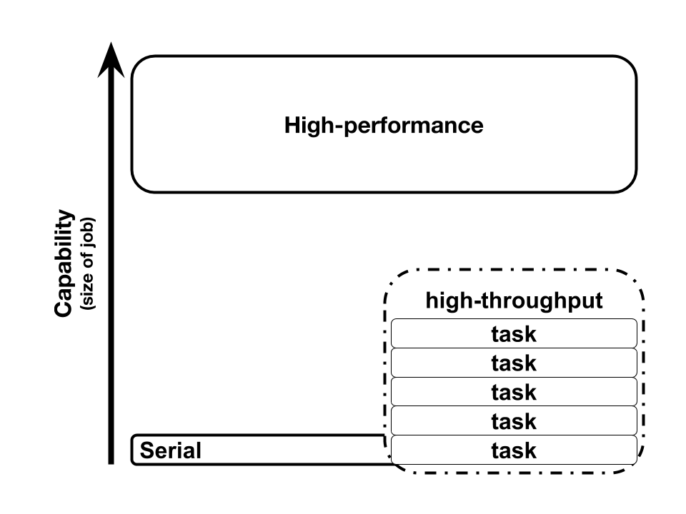
HPC vs HTC

Slide 4



CURC loadbalancer
Notes:
As with most computing problems there are a variety of tools available. In an expanded version of this talk, we go over several ways to do this.

Slide 5
CURC loadbalancer
Notes:
But today, we're only going to cover the two that are most likely to actually be useful to you. We'll talk about Slurm job arrays, a primary feature of our batch queueing system; and the CURC loadbalancer, a custom tool we provide but that is available on github and could be used on any MPI-enabled cluster.

Slide 6
Batch job with one serial task
#!/bin/bash
module purge
module load python
time python matrix-multiply.py \
data/input_0.csv
https://github.com/ResearchComputing/Parallelization_Workshop/blob/master/Day2-HTC/examples/bash-single-task.sh
Notes:
Task definition: One or more commands to run. For this tutorial we’re going to say a task is serial.
Job definition: One or more tasks submitted to the Slurm scheduler and run on compute nodes.
This is a bash script which will submit job which runs a Python script. Specifically it runs matrix-multiply.py with an input of input_0.csv. Lets
say the goal of this script is to process that file.

Slide 7
Batch job with multiple tasks Serial scripts run in sequence
#!/bin/bash
module purge
module load python
time ( for input in data/input_{0..9}.csv
do python matrix-multiply.py ${input} done
)
https://github.com/ResearchComputing/Parallelization_Workshop/blob/master/Day2-HTC/examples/bash-multiple-tasks.sh

Slide 8
Slurm job arrays
Submit multiple sub-jobs from a single job script
Array indices specified by --array
For example, --array 0-9
Array index is available as
$SLURM_ARRAY_TASK_ID (in the job)
%a (in --output)
Master job id is available as
$SLURM_ARRAY_JOB_ID (in the job)
%A (in --output)

Slide 9
Slurm job arrays Example
#!/bin/bash #SBATCH --array 0-9 #SBATCH --output slurm-array-%A.%a.out echo "Master job id: ${SLURM_ARRAY_JOB_ID}"
echo "Array index: ${SLURM_ARRAY_TASK_ID}"

Slide 10
Exercise 1 Slurm job arrays
Submit bash-multiple-tasks.sh as a Slurm job array. Each array task should execute a single matrix-multiply.py process.
https://github.com/ResearchComputing/Basics_Supercomputing/blob/master/2017_July/Day_Two/%5B09%5D_htc/exercises/exercise1.md

Slide 11
Exercise 1 (solution) Slurm job arrays
#!/bin/bash #SBATCH --job-name htc-exercise1-slurm-arrays #SBATCH --ntasks 1 #SBATCH --array 0-9 #SBATCH --output htc-exercise1-%A.%a.out #SBATCH --time 00:01:00 module purge module load python time python matrix-multiply.py \
data/input_${SLURM_ARRAY_TASK_ID}.csv

Slide 12
Exercise 1 (solution) Slurm job arrays
$ sbatch --reservation basics17 \
> solutions/exercise1 .sh

Slide 13
Slurm job arrays summary
Standard Slurm semantics (and similar features exist on other schedulers)
Incurs additional scheduling overhead
Runs on multiple nodes

Slide 14
CURC loadbalancer
Submitting hundreds of Slurm jobs is inefficient (even using job arrays)
Balances serial applications using MPI (without needing knowledge of MPI!)
Schedules tasks across multiple nodes from one job
Choose how many tasks will run at a time
Starts tasks in order (no control over output order)
Automatically replaces finished tasks with new tasks
Straightforward input format
Notes:
Talk about start/stop overhead, scheduling overhead

Slide 15
CURC loadbalancer Input file format
One task per line
Each task may run multiple commands, each command separated by a semicolon
for input in data/input_{0..9}.csv do echo >>lb_cmd_file \
"wc -l ${input} >$(basename ${input})-lines"
done

Slide 16
CURC loadbalancer Input file format
wc -l data/input_0.csv >input_0.csv-lines
wc -l data/input_1.csv >input_1.csv-lines
wc -l data/input_2.csv >input_2.csv-lines
wc -l data/input_3.csv >input_3.csv-lines
wc -l data/input_4.csv >input_4.csv-lines
wc -l data/input_5.csv >input_5.csv-lines
wc -l data/input_6.csv >input_6.csv-lines
wc -l data/input_7.csv >input_7.csv-lines
wc -l data/input_8.csv >input_8.csv-lines
wc -l data/input_9.csv >input_9.csv-lines

Slide 17
CURC loadbalancer Input file format
$ bash lb_cmd_file
$ cat input_?.csv-lines \
> | awk '{total+=$1} END { print total }'
1000
Notes:
We could actually just execute this input file as a shell script itself.

Slide 18
CURC loadbalancer Execution
#!/bin/bash module purge module load intel impi module load loadbalance mpirun lb lb_cmd_file

Slide 19
Exercise 2 CURC loadbalancer with Slurm
Convert the solution from exercise 1 ("Slurm job arrays") to use the CURC loadbalancer in a single, multi-task job, rather than Slurm job arrays.
Try multiple values for --ntasks and observe the execution time change.
Each task / input file line should execute a single matrix-multiply.py process.
How might you combine the output from the different tasks into asingle output file?
https://github.com/ResearchComputing/Basics_Supercomputing/blob/master/2017_July/Day_Two/%5B09%5D_htc/exercises/exercise2.md

Slide 20
Exercise 2 (solution) CURC loadbalancer with Slurm
#!/bin/bash #SBATCH --job-name htc-exercise2-lb #SBATCH --ntasks 10 #SBATCH --output htc-exercise2-%j.out #SBATCH --time 00:02:00 module purge module load python intel impi loadbalance ( for input in data/input_{0..9}.csv do output="${SLURM_JOB_ID}-$(basename ${input%.csv}).out" echo "python matrix-multiply.py ${input} >${output}" done ) >lb_cmd_file-${SLURM_JOB_ID} time (
mpirun lb lb_cmd_file-${SLURM_JOB_ID}
cat htc-exercise2-${SLURM_JOB_ID}-*.out \
>htc-exercise2-${SLURM_JOB_ID}.out
rm htc-exercise2-${SLURM_JOB_ID}-*.out
)

Slide 21
Exercise 2 (solution) CURC loadbalancer with Slurm
$ sbatch --reservation parallelD2 \
> solutions/exercise2.sh
$ sbatch --reservation parallelD2 \
> --ntasks 5 \
> solutions/exercise2.sh

Slide 22
CURC loadbalancer summary
Benefit from low-overhead mpi task scheduling with no knowledge of mpi required
Saves time by reducing scheduling overhead
Runs on multiple nodes
Input file can be created in your favorite language
Non-standard (but it is on github)
https://github.com/ResearchComputing/lb

Slide 23
References
Bash scripting
https://www.rc.colorado.edu/blog/reducejanuswaittimes
Slurm arrays
https://slurm.schedmd.com/job_array.html
CURC loadbalancer
https://github.com/ResearchComputing/lb
https://www.rc.colorado.edu/support/examples-and-tutorials/load-balancer.html

Slide 24
Questions?
Email rc-help@colorado.edu
Survey: http://tinyurl.com/curc-survey16
Speaker: Jonathon Anderson
Title: Efficient Submission of Serial Jobs July 2017 BSW
Slides: https://github.com/ResearchComputing/Basics_Supercomputing

